Slide 1
Exploratory Data Analysis
Churn Model

Slide 2
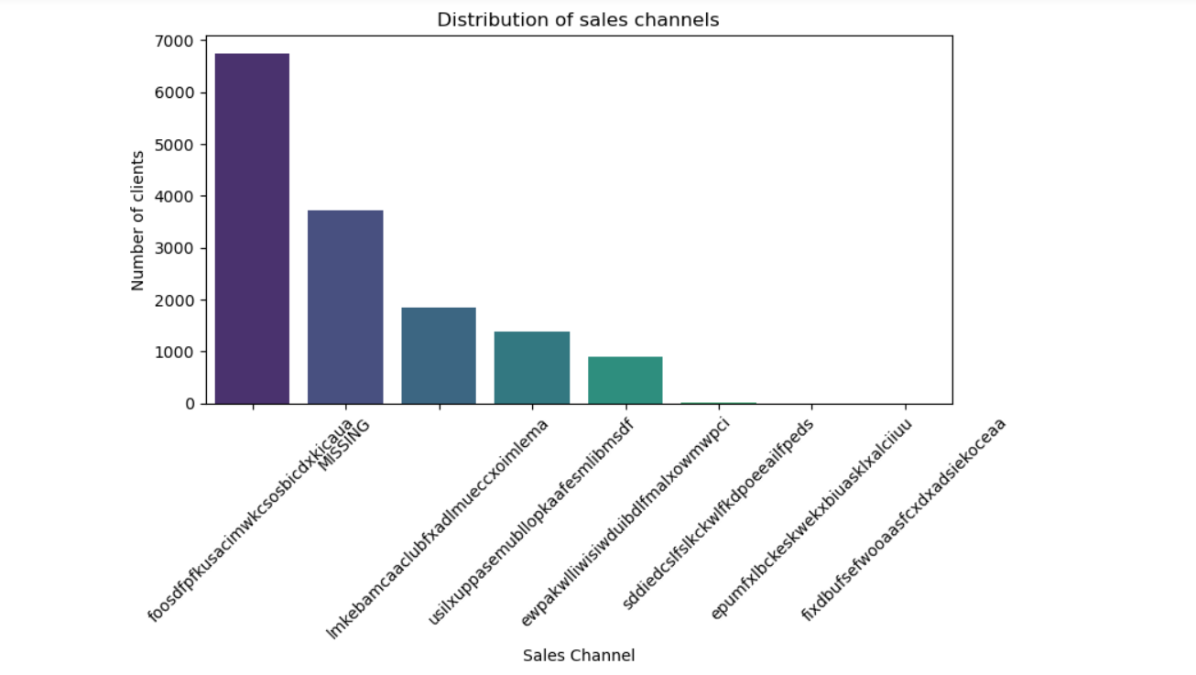
Sales Channel
Missing channel contains a potential number of clients.

Slide 3
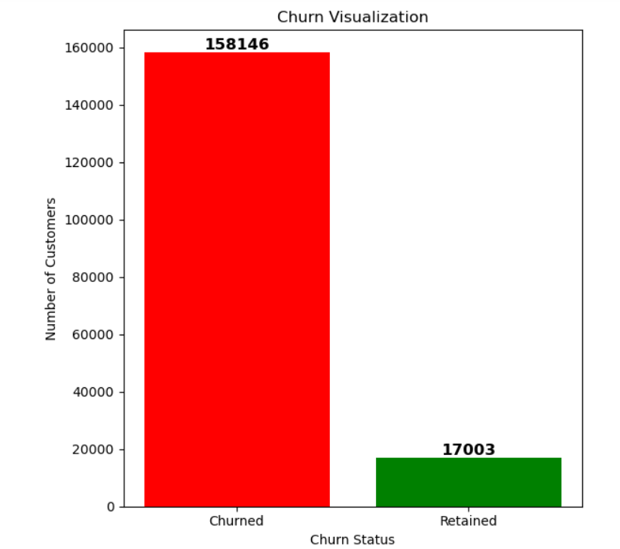
Churn Rate
In last 3 months, more than 1,50,000 churns have occurred.
Around 17,000 people have retained.

Slide 4
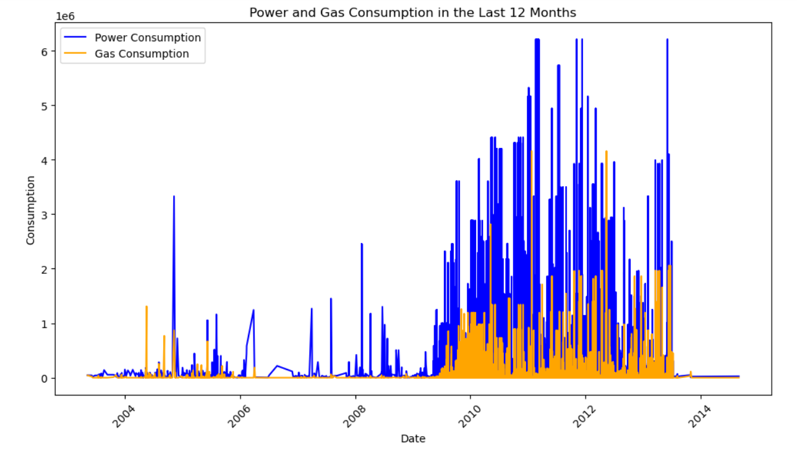
Power and Gas Consumption
Power consumption is higher than gas consumption
In last 12 months, Consumption of both Power and Gas is increasing with year.

Slide 5
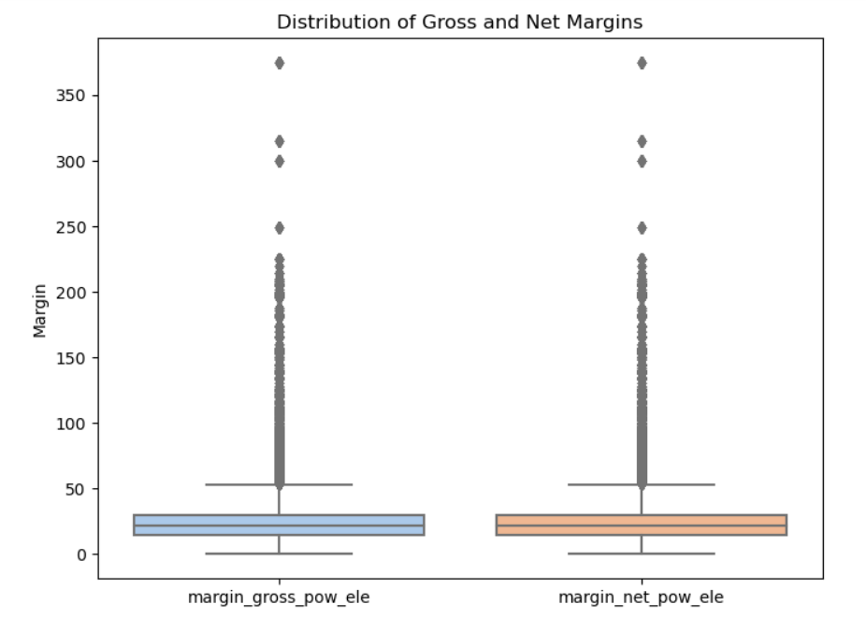
Distribution of Gross margin and Net margin
Outliers are present in the data.
The distribution of gross margin and net margin are similar.

Slide 6
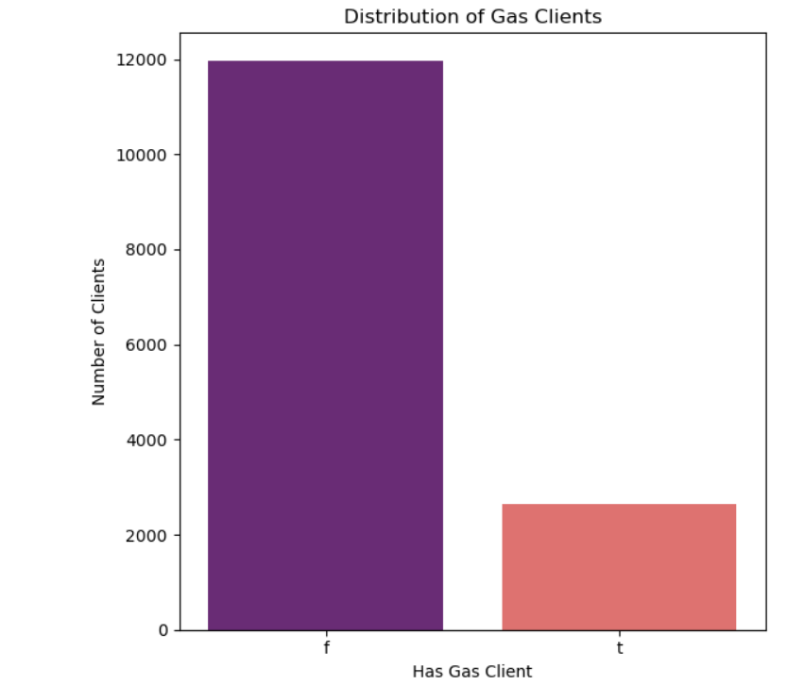
Clients Distribution
More than 2,000 are gas clients.
About 12,000 of clients are non gas clients.

Slide 7
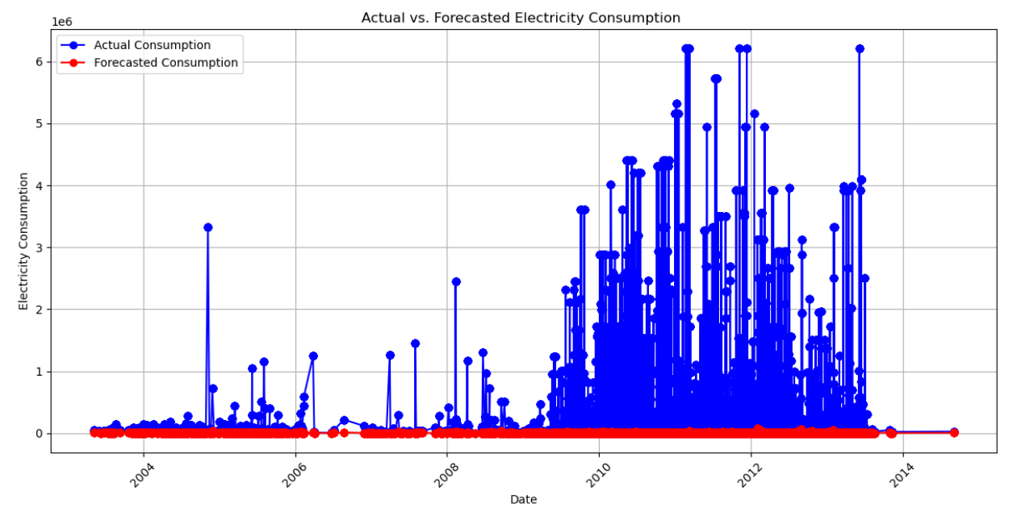
Actual Vs. Forecasted Electricity Consumption Trend
Actual consumption rate is comparatively much higher than the forecasted consumption rate.
The electricity has been consumed at higher rate between 2009 and 2013.
The forecasted model has underestimated the consumption rate.

Slide 8
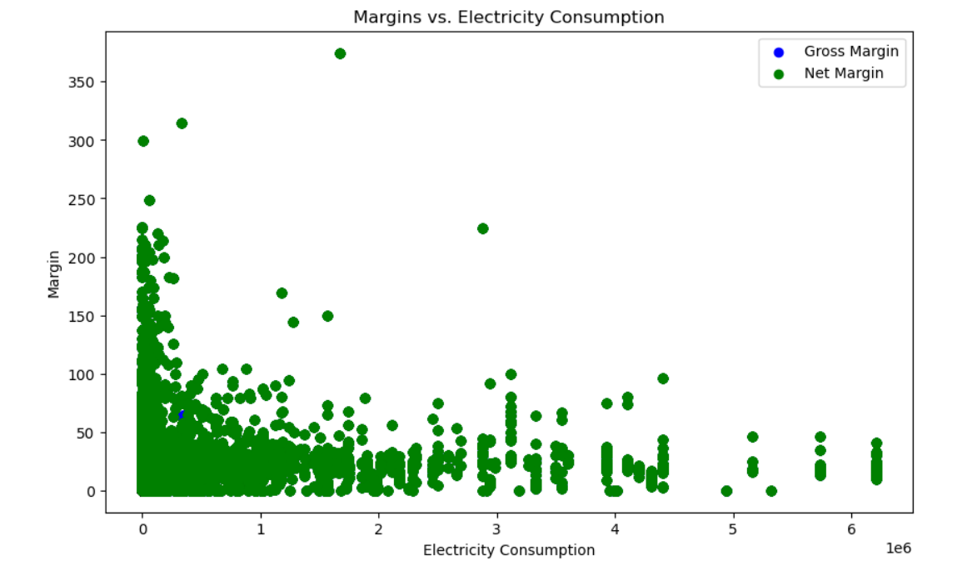
Margin Vs. Electricity Consumption
Higher is the Electricity consumption rate , Lower is the Net Margin.
A large number of customers have relatively similar margin values at lower levels of electricity consumption.

Slide 9
Suggestions
Missing channel with large number of clients suggests that there may be untapped market segment that is attracting a substantial customer base. Identifying it can help expand the reach and increase the sales revenue.
Higher churn rate indicates issues with the potential customer satisfaction and services.
Based on the increasing trend of power and gas consumption , a plan is required for the capacity requirements and resource allocations.
Outliers need to be treated .
Serving both gas and non-gas clients reflects a diversified customer base. Exploring untapped opportunities can help in expansion and marketing strategies.

Slide 10
Revaluate the forecasting technique used to predict the electricity consumption rate .
Consider adopting advanced technology such as hybrid forecasting or time series analysis to capture the complex pattern of electricity consumption .
Conducting a customer profitability research can help understand the potential customers.
Focusing on retaining high margin customers to enhance overall profitability.

Slide 11

Thank You

